Slide 1
LED Cube
Using Arduino UNO

Slide 2
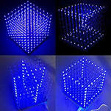
LED Cube is just multiplexing
Using 3 to 8 decoders we can run multiple LED using
Very less inputs

Slide 3
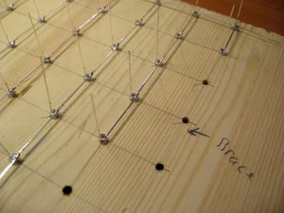
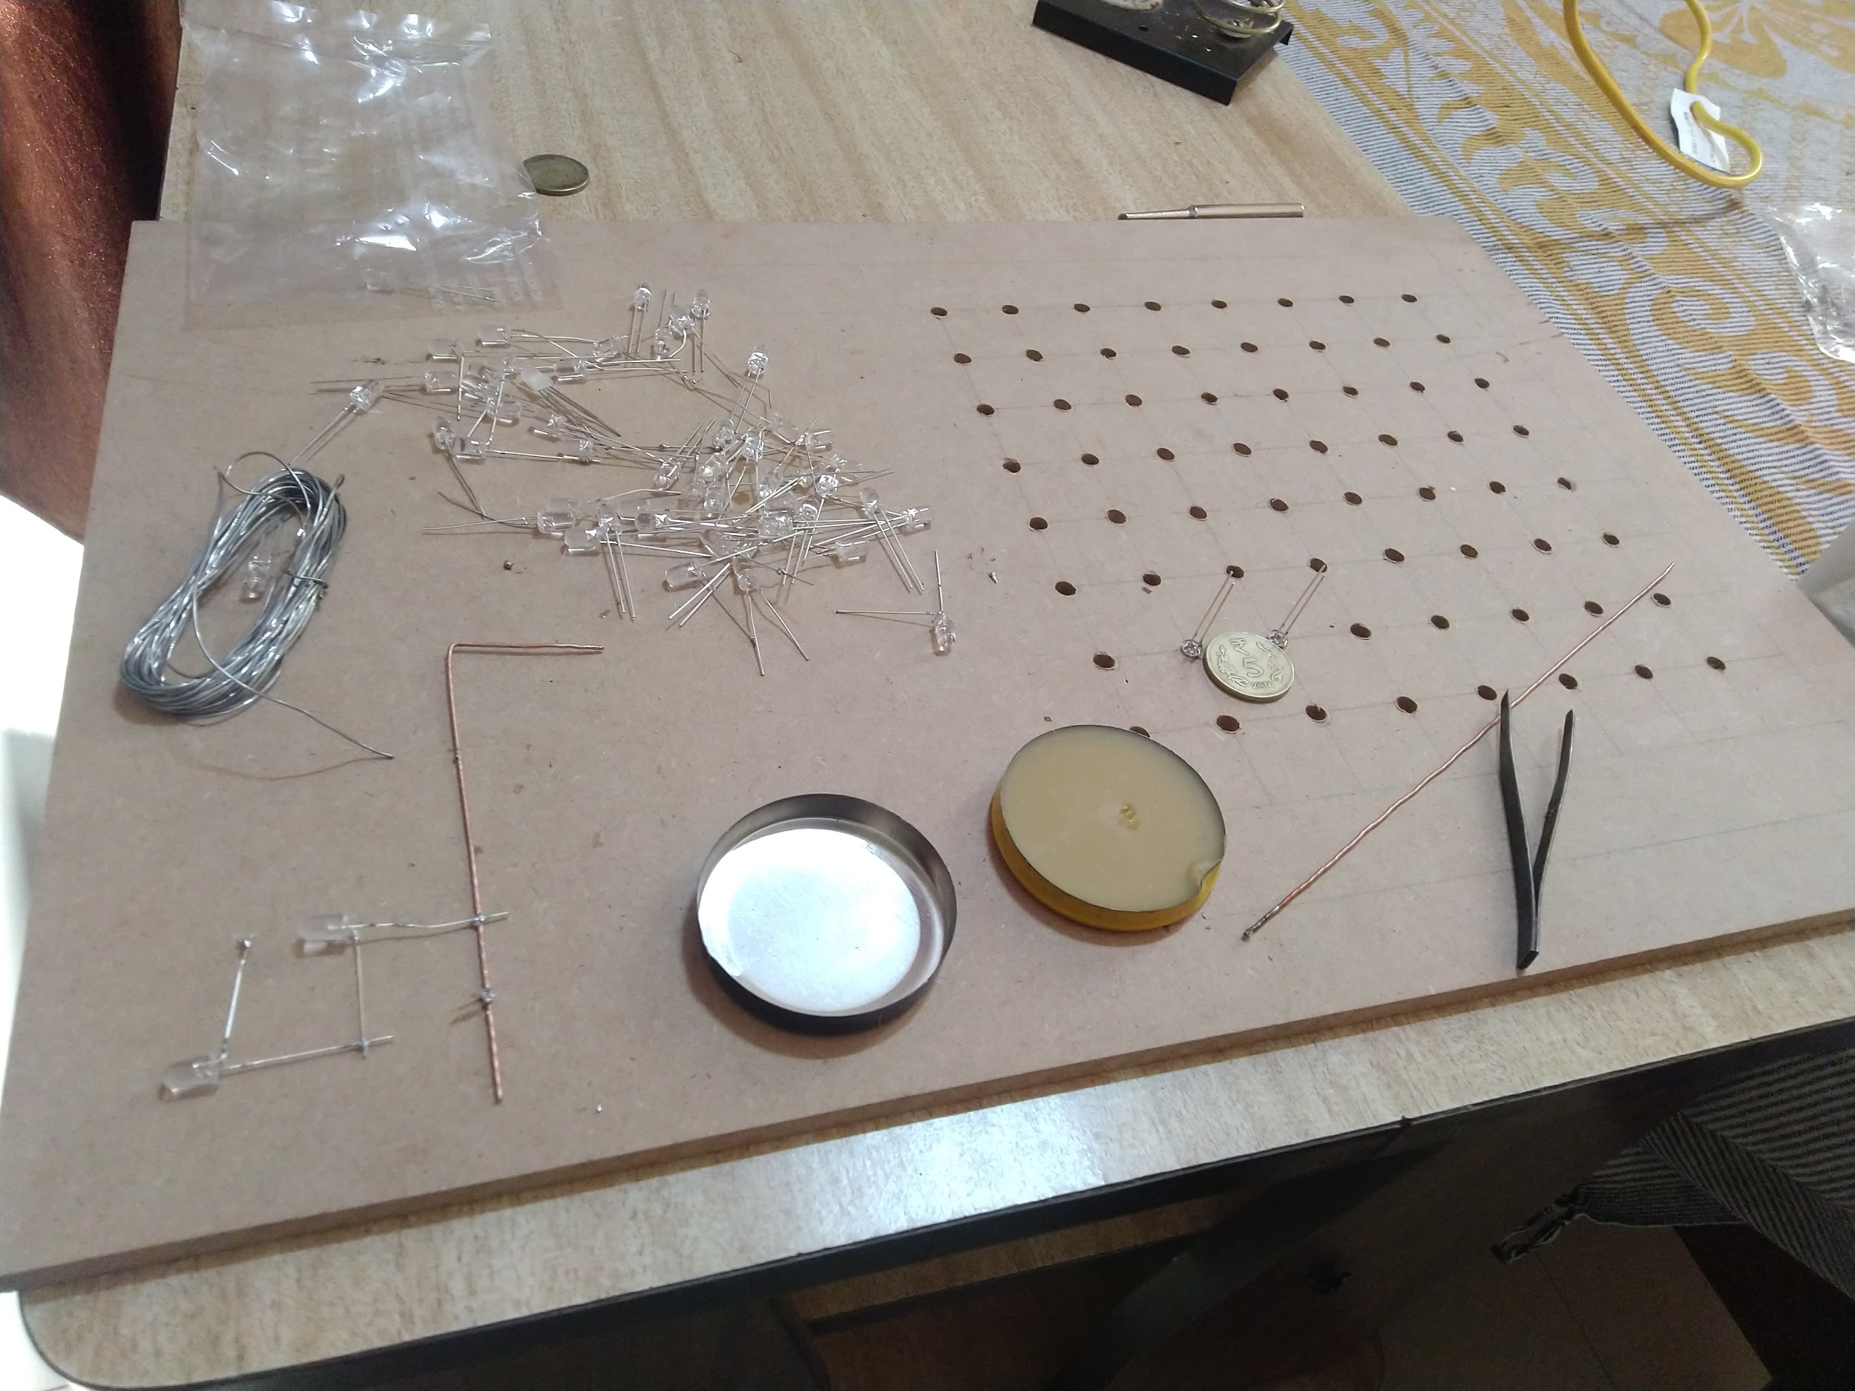
Soldering the individal sets

Slide 4
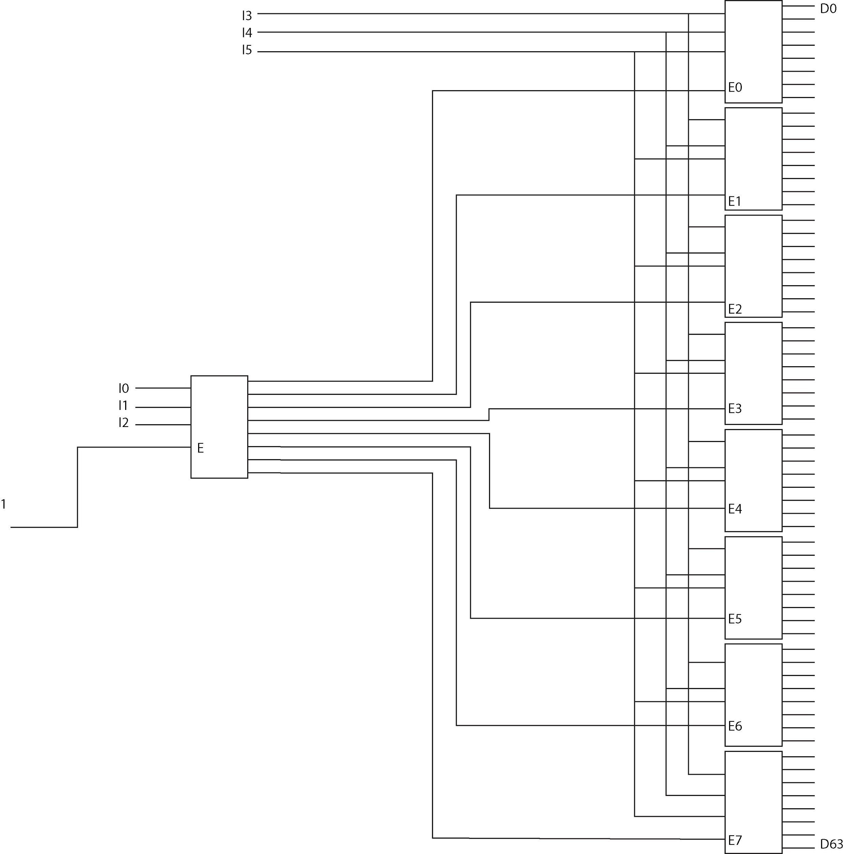
Multiplexing pattern
How to use decoders to
Multiplex a binary output
To a visible output for
LEDs

Slide 5

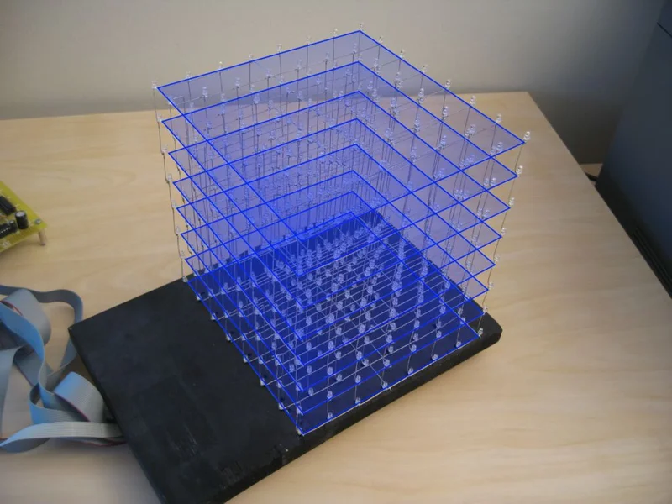
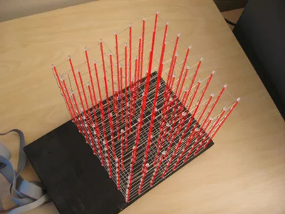
Soldering scheme

Slide 6


Slide 7
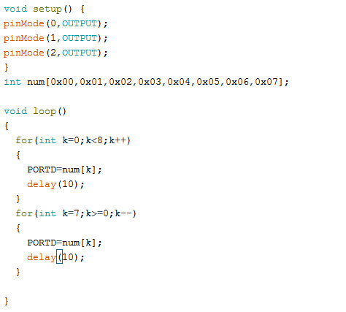
Code:-

